Slide 1
Questionario OPIS
Accedere all’area personale studente di INFOSTUD.
Selezionare CORSI DI LAUREA → Opinioni studenti
Inserire il codice OPIS 0Q25Y5DH e compilare il questionario

Slide 2
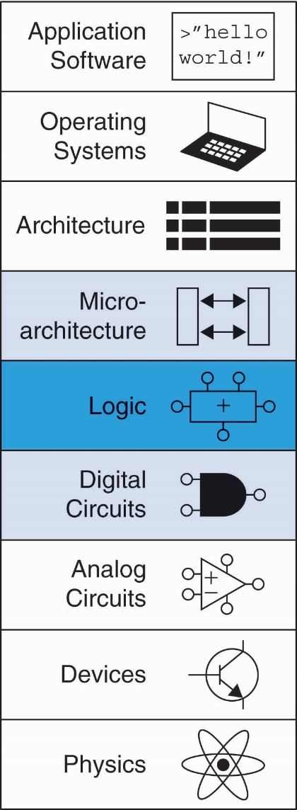
Chapter 5 :: Topics
Introduction
Arithmetic Circuits
Number Systems
Sequential Building Blocks
Memory Arrays
Logic Arrays

Slide 3
Introduction
Digital building blocks:
Gates, multiplexers, decoders, registers, arithmetic circuits, counters, memory arrays, logic arrays
Building blocks demonstrate hierarchy, modularity, and regularity:
Hierarchy of simpler components
Well-defined interfaces and functions
Regular structure easily extends to different sizes
Building blocks used to build microprocessor

Slide 4
1-Bit Adders

Slide 5
1-Bit Adders

Slide 6
1-Bit Adders

Slide 7
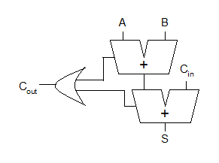
1-Bit Adders
Full Adders from Half Adder
The Full adder can be composed starting from 2 Half-Adders

Slide 8
Multibit Adders (CPAs)
Types of carry propagate adders (CPAs):
Ripple-carry (slow)
Carry-lookahead (fast)
Prefix (faster)
Carry-lookahead and prefix adders faster for large adders but require more hardware
Symbol

Slide 9
Ripple-Carry Adder
Chain 1-bit adders together
Carry ripples through entire chain
Disadvantage: slow

Slide 10
Ripple-Carry Adder Delay
t_{ripple} = Nt_{FA}
where t_{FA} is the delay of a 1-bit full adder

Slide 11
Carry-Lookahead Adder
Compute C_{out} for k-bit blocks using generate and propagate signals

Slide 12
Carry-Lookahead Adder
Compute C_{out} for k-bit blocks using generate and propagate signals
Some definitions:
Column i produces a carry out by either generating a carry out or propagating a carry in to the carry out

Slide 13
Carry-Lookahead Adder
Compute C_{out} for k-bit blocks using generate and propagate signals
Some definitions:
Column i produces a carry out by either generating a carry out or propagating a carry in to the carry out
Generate (G_{i}) and propagate (P_{i}) signals for each column:

Slide 14
Carry-Lookahead Adder
Compute C_{out} for k-bit blocks using generate and propagate signals
Some definitions:
Column i produces a carry out by either generating a carry out or propagating a carry in to the carry out
Generate (G_{i}) and propagate (P_{i}) signals for each column:
Generate: Column i will generate a carry out if A_{i} and B_{i} are both 1.
G_{i} = A_{i} B_{i}

Slide 15
Carry-Lookahead Adder
Compute C_{out} for k-bit blocks using generate and propagate signals
Some definitions:
Column i produces a carry out by either generating a carry out or propagating a carry in to the carry out
Generate (G_{i}) and propagate (P_{i}) signals for each column:
Generate: Column i will generate a carry out if A_{i} and B_{i} are both 1.
G_{i} = A_{i} B_{i}
Propagate: Column i will propagate a carry in to the carry out if A_{i} or B_{i} is 1.
P_{i} = A_{i} + B_{i}

Slide 16
Carry-Lookahead Adder
Compute C_{out} for k-bit blocks using generate and propagate signals
Some definitions:
Column i produces a carry out by either generating a carry out or propagating a carry in to the carry out
Generate (G_{i}) and propagate (P_{i}) signals for each column:
Generate: Column i will generate a carry out if A_{i} and B_{i} are both 1.
G_{i} = A_{i} B_{i}
Propagate: Column i will propagate a carry in to the carry out if A_{i} or B_{i} is 1.
P_{i} = A_{i} + B_{i}
Carry out: The carry out of column i (C_{i}) is:
C_{i} = A_{i} B_{i} + (A_{i} + B_{i} )C_{i-1} = G_{i} + P_{i} C_{i-1}

Slide 17
Block Propagate and Generate
Now use column Propagate and Generate signals to compute Block Propagate and Generate signals for k-bit blocks, i.e.:
Compute if a k-bit group will propagate a carry in (to the block) to the carry out (of the block)
Compute if a k-bit group will generate a carry out (of the block)

Slide 18
Block Propagate and Generate Signals
Example: Block propagate and generate signals for 4-bit blocks (P_{3:0} and G_{3:0}):
P_{3:0} = P₃P₂ P₁P₀
G_{3:0} = G₃ + P₃ (G₂ + P₂ (G₁ + P₁G₀ )
Generally,
P_{i:j} = P_{i}P_{i-1} P_{i-2}P_{j}
G_{i:j} = G_{i} + P_{i} (G_{i-1} + P_{i-1} (G_{i-2} + P_{i-2}G_{j} ))
C_{i} = G_{i:j} + P_{i:j} C_{j-1}

Slide 19
32-bit CLA with 4-bit Blocks

Slide 20
32-bit CLA with 4-bit Blocks
Critical path is reduced to t_{AND_OR}

Slide 21
Carry-Lookahead Addition
Step 1: Compute G_{i} and P_{i} for all columns
Step 2: Compute G and P for k-bit blocks
Step 3: C_{in} propagates through each k-bit propagate/generate logic (meanwhile computing sums)
Step 4: Compute sum for most significant k-bit block

Slide 22
32-bit CLA with 4-bit Blocks

Slide 23
Carry-Lookahead Adder Delay
For N-bit CLA with k-bit blocks:
t_{CLA} = t_{pg} + t_{pg_block} + (N/k – 1)t_{AND_OR} + kt_{FA}
t_{pg} : delay to generate all P_{i}, G_{i}
t_{pg_block} : delay to generate all P_{i:j}, G_{i:j}
t_{AND_OR} : delay from C_{in} to C_{out} of final AND/OR gate in k-bit CLA block
An N-bit carry-lookahead adder is generally much faster than a ripple-carry adder for N > 16

Slide 24
Esercizio

Slide 25
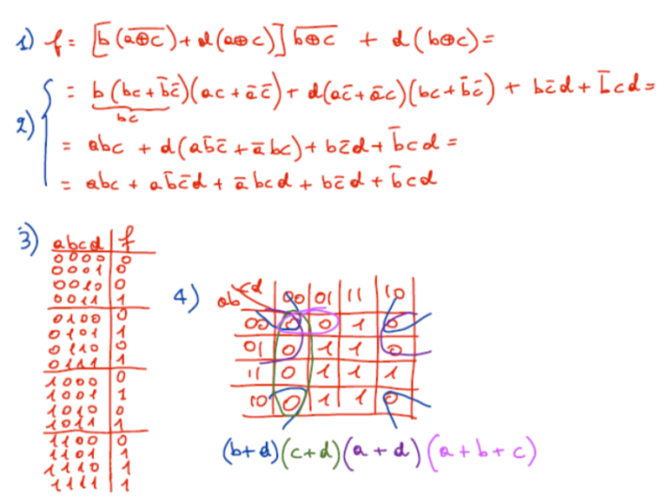
Esercizio

Slide 26
Esercizio

Slide 27
Esercizio

Slide 28
Esercizio

Slide 29
Esercizio

Slide 30
Esercizio

